Slide 1


ASEN 6519, Spring 2017 Algorithms for Aerospace Autonomy Lecture 24: Approximate POMDPS Luke Burks 04/20/2017

Slide 2
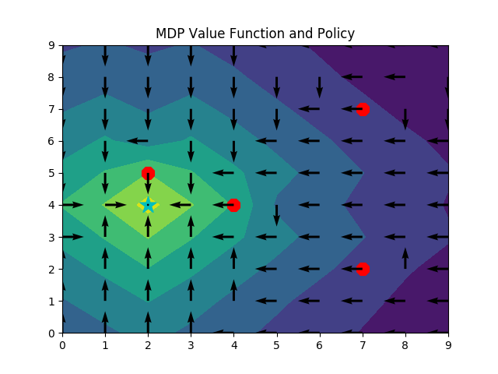
MDP: Modified Europa Hopper Problem
Notes:
100 States, 5 actions
Go to the blue star, avoid the red circles
Notice how the value function deforms around the circles
It’s literally how valuable it is to be in a spot

Slide 3
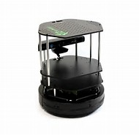

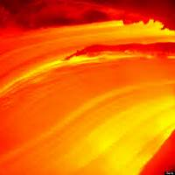

MDP: The simpler hallway problem
A robot is in a hallway trying to find the power outlet
Also, there’s lava at each end of the hallway…
0
10
20
Notes:
By the way, the lava’s not a cop-out, its to help visualize the rewards easier
Robot can move in a direction, but he doesn’t always succeed and might stay still

Slide 4
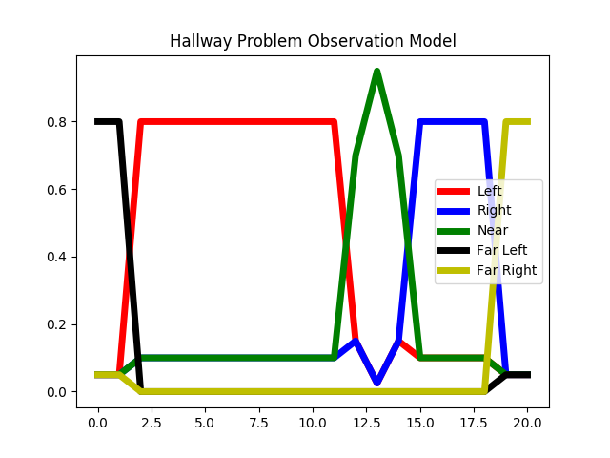
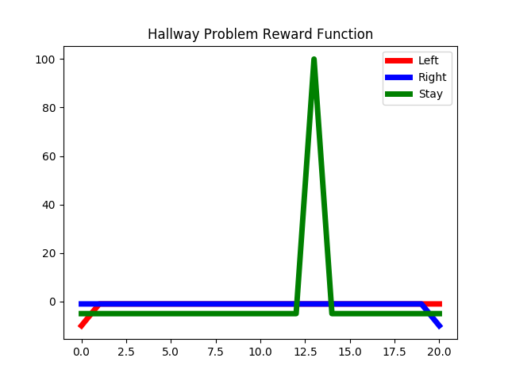
MDP: The simpler hallway problem
The hallway is discretized into 21 spaces
The robot can take 3 actions, and receive 5 observations
Stuff
Notes:
Note: can localize well at the far ends, but then there’s a chance you might fall in lava

Slide 5
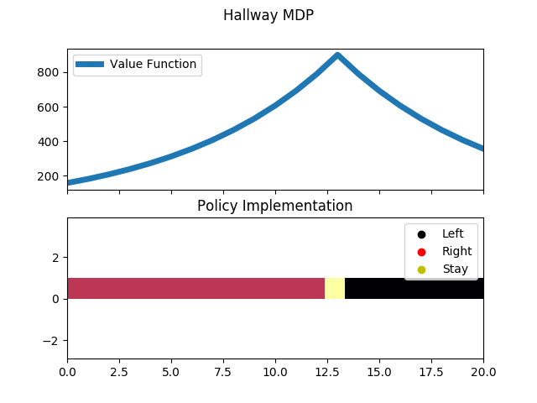
MDP: The simpler hallway problem
Notes:
Function curves due to the discount factor
Action bar (trademark pending) for showing what to do at each state

Slide 6
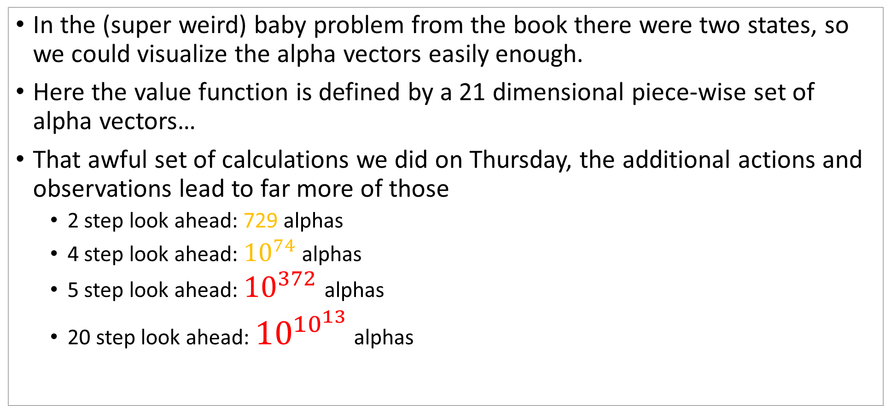
Why this is hard with a POMDP
In the (super weird) baby problem from the book there were two states, so we could visualize the alpha vectors easily enough.
Here the value function is defined by a 21 dimensional piece-wise set of alpha vectors…
That awful set of calculations we did on Thursday, the additional actions and observations lead to far more of those
2 step look ahead: 729 alphas
4 step look ahead: ${10}^{74}$ alphas
5 step look ahead: ${10}^{372}$ alphas
20 step look ahead: ${10}^{{10}^{13}}$ alphas
Notes:
After 4 steps we pass the estimated number of subatomic particles in the universe
By the time we’ve looked forward far enough to think about getting to the other side of the hallway, things just get out of hand…
Of course pruning becomes important, but pruning can be kind of expensive in a 21 dimensional space. You have to be able to assert that NO belief prefers a particular alpha

Slide 7
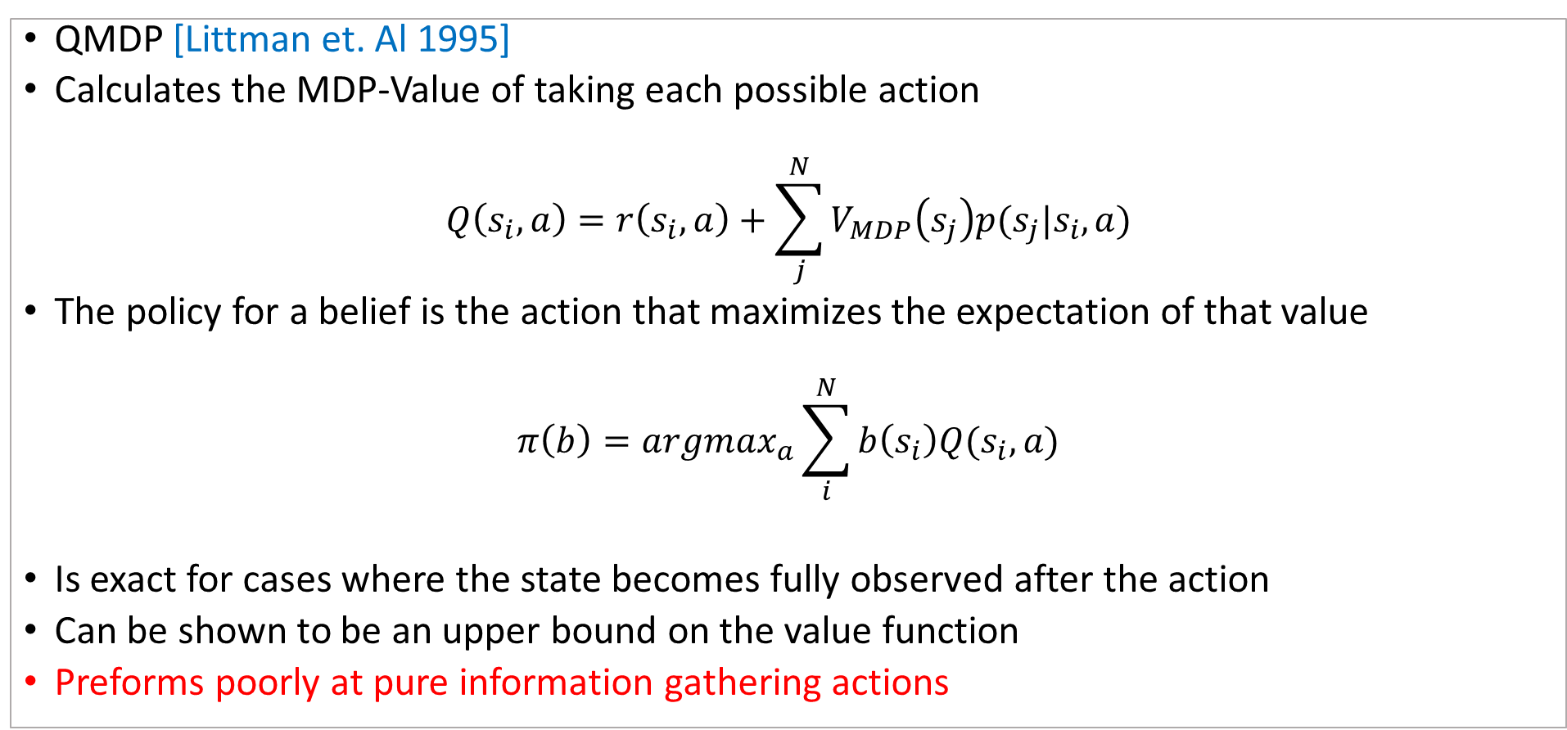
QMDP: What if we pretend it’s actually an MDP?
QMDP [Littman et. Al 1995]
Calculates the MDP-Value of taking each possible action
$$Q\left(s_{i},a\right)=r\left(s_{i},a\right)+\sum_{j}^{N}{V_{MDP}\left(s_{j}\right)p(s_{j}|s_{i},a)}$$
The policy for a belief is the action that maximizes the expectation of that value
$$π\left(b\right)=argmax_{a}\sum_{i}^{N}{b\left(s_{i}\right)Q(s_{i},a)}$$
Is exact for cases where the state becomes fully observed after the action
Can be shown to be an upper bound on the value function
Preforms poorly at pure information gathering actions
Notes:
Similar to if you put a prior on the MDP
This works better than you’d think it would

Slide 8
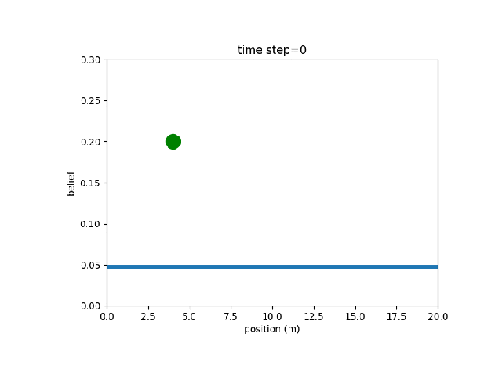
QMDP Simulation Example
Notes:
This is a GIF

Slide 9
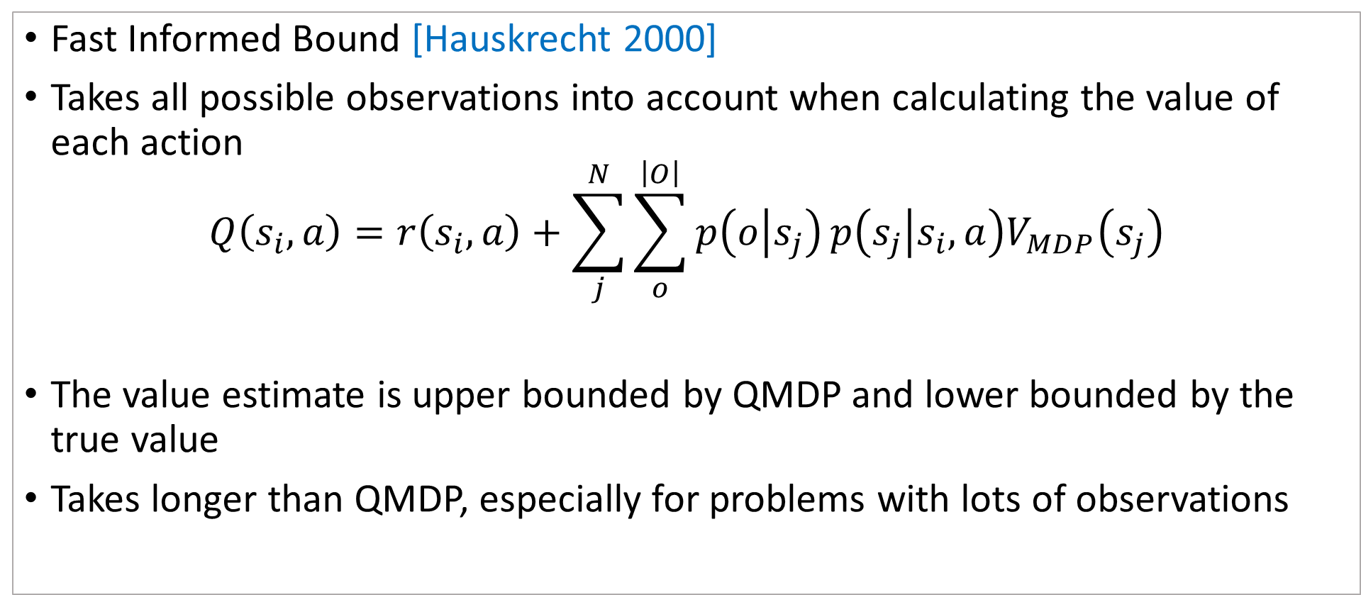
FIB: What if we only kind of pretend its actually an MDP?
Fast Informed Bound [Hauskrecht 2000]
Takes all possible observations into account when calculating the value of each action
$$Q\left(s_{i},a\right)=r\left(s_{i},a\right)+\sum_{j}^{N}{\sum_{o}^{\left|O\right|}{p\left(o | s_{j}\right)}p\left(s_{j} | s_{i},a\right)V_{MDP}\left(s_{j}\right)}$$
The value estimate is upper bounded by QMDP and lower bounded by the true value
Takes longer than QMDP, especially for problems with lots of observations

Slide 10
MDP: Just a reminder

Slide 11
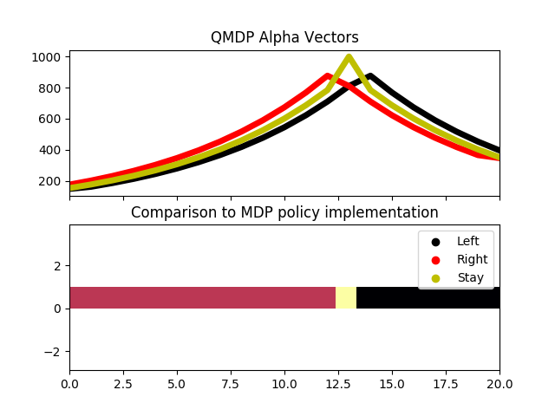
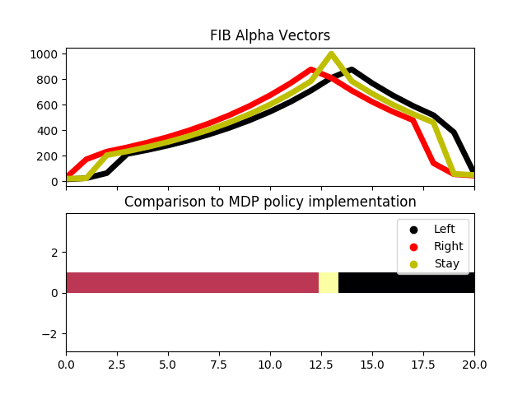
QMDP vs. FIB

Slide 12
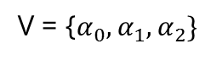
PBVI: Do we have to care about ALL the beliefs?
Point-Based Value Iteration [Pineau et. al 2003]
Given some starting belief, there are many beliefs you’ll never encounter no matter the sequence of actions and observations
Use what you know about the beliefs you’ve seen to tell you what to do at new beliefs
V = {$α_{0},α_{1},α_{2}\}$
b0
b1
b2
b3
b4
Notes:
Value Iteration is how we found the MDP policy
Think of these as tent poles.
Super popular approach

Slide 13
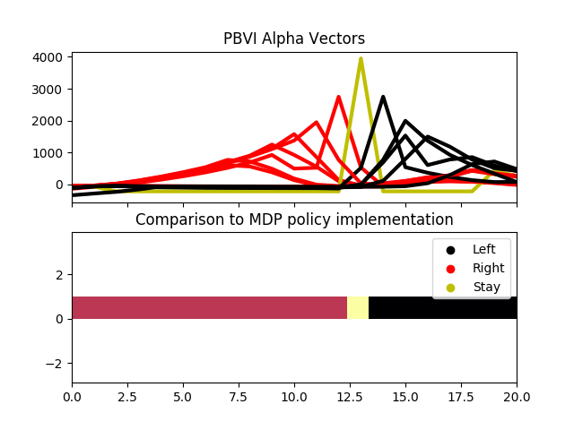
PBVI: Do we have to care about ALL the beliefs?

Slide 14
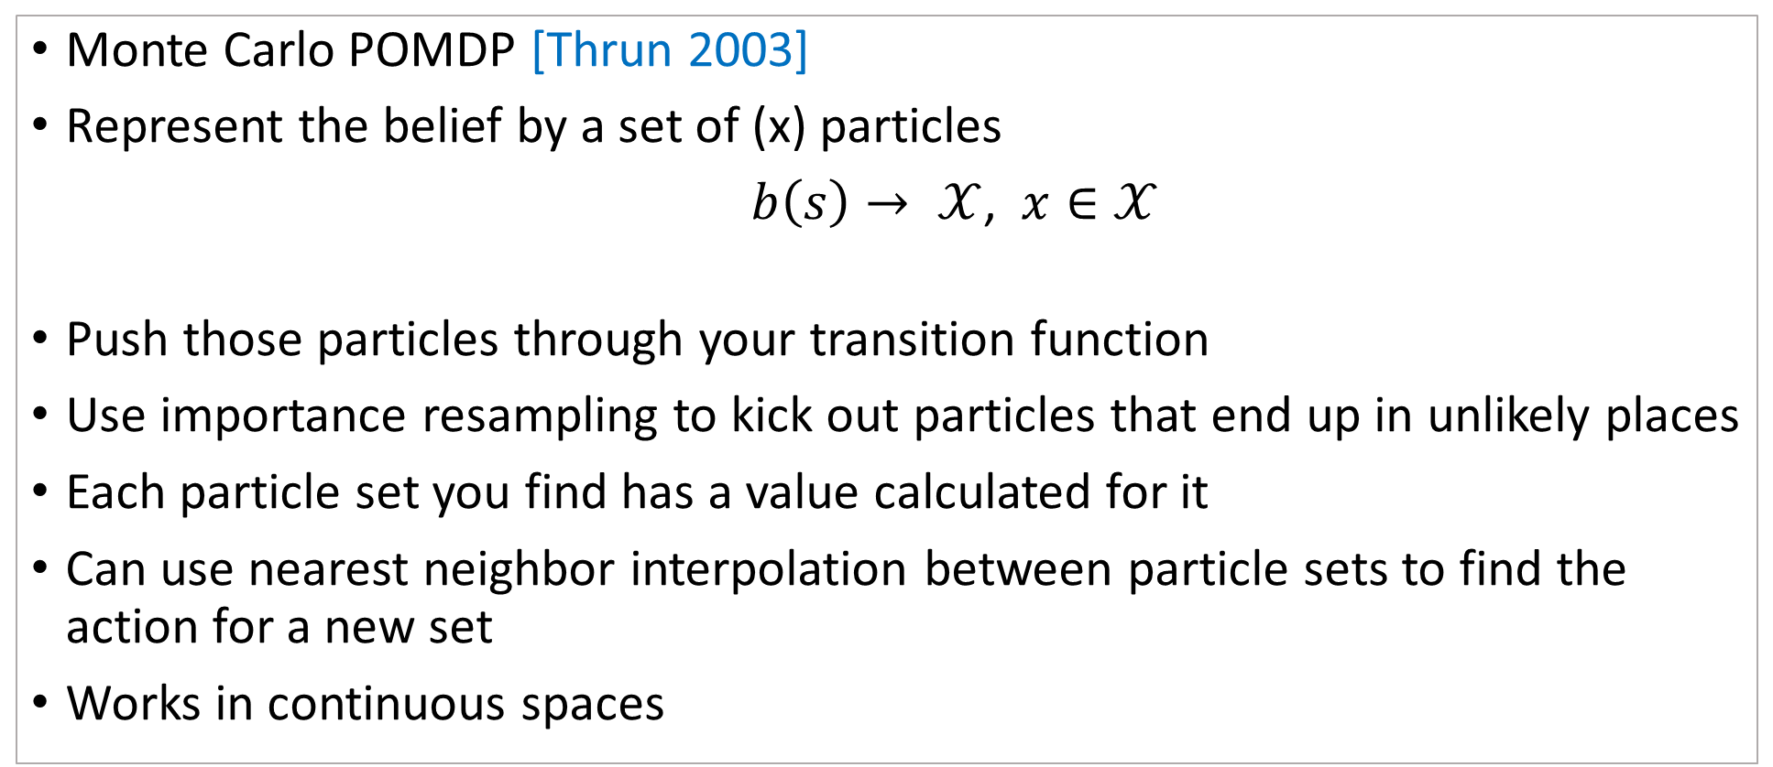
MC-POMDP: Because putting Monte Carlo in front of anything makes it possible right?
Monte Carlo POMDP [Thrun 2003]
Represent the belief by a set of (x) particles
$b\left(s\right)→ 𝒳$, $x∈𝒳$
Push those particles through your transition function
Use importance resampling to kick out particles that end up in unlikely places
Each particle set you find has a value calculated for it
Can use nearest neighbor interpolation between particle sets to find the action for a new set
Works in continuous spaces

Slide 15
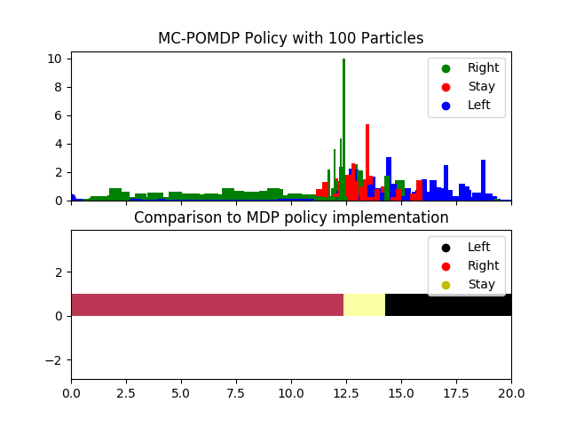
MC-POMDP: Because putting Monte Carlo in front of anything makes it possible right?

Slide 16
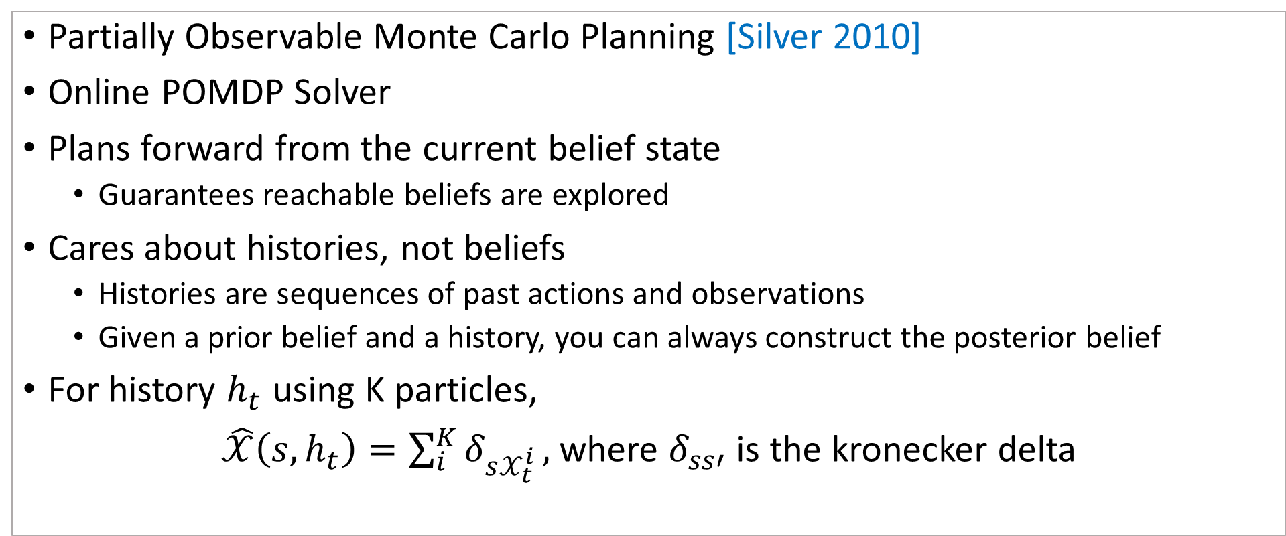
POMCP: When your problem requires a state for every atom in the solar system…
Partially Observable Monte Carlo Planning [Silver 2010]
Online POMDP Solver
Plans forward from the current belief state
Guarantees reachable beliefs are explored
Cares about histories, not beliefs
Histories are sequences of past actions and observations
Given a prior belief and a history, you can always construct the posterior belief
For history $h_{t}$ using K particles,
$\hat{𝒳}\left(s,h_{t}\right)=\sum_{i}^{K}{δ_{s𝒳_{t}^{i}}},$where $δ_{ss′}$ is the kronecker delta

Slide 17
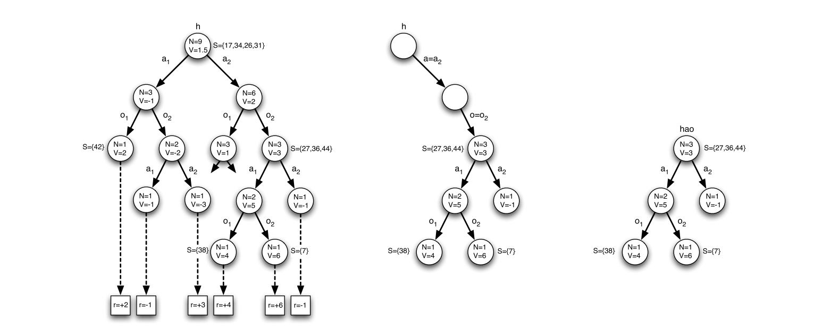
POMCP: When your problem requires a state for every atom in the solar system…
Builds a tree of possible future histories
When an action is taken and an observation received, the root is moved down the corresponding branches while other branches are pruned
Notes:
Why not always use this?
Requires being run online, which means it’s less able to implement on low power platforms
Usually works well, but was shown by (Hsu 2013) to have extremely poor worst case-performance
So it’s a bit more of a dice roll than an offline method
Depends on depth parameter d, for how far to search forward

Slide 18
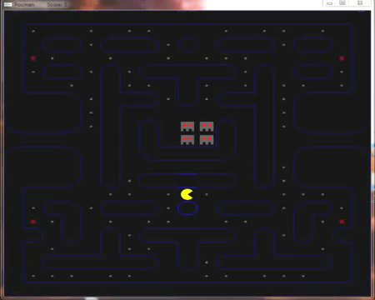
POMCP: In action
10^56 States
1024 Obs
4 Actions
Notes:
Yay videos
Pocman can hear ghosts near him, he can see ghosts in a particular direction, he can feel walls around him, and he can smell fruit

